Slide 1
Robotic Odor Source Localization Using Vison and Olfaction
Sunzid Hassan
Advisor: Dr. Lingxiao Wang
Computational Analysis and Modelling (CAM)
Louisiana Tech University
23 October, 2025.

Slide 2
Outline
Slide 1: Significance, Current Status, Challenges, and Objectives.
Slide 2: Method.
Slide 3: Results.
Slide 4: Conclusion and Future Work.

Slide 3
Robotic Odor Source Localization
Significance: wildfire monitoring, finding hazardous gas leaks, etc.
Traditional Olfactory-based Navigation Algorithms
Chemotaxis
Odor-gated Anemotaxis
Engineering-based Methods
Challenges:
Turbulent airflow
Obstacles
Objective: Integrating vision and olfaction for OSL

Slide 4



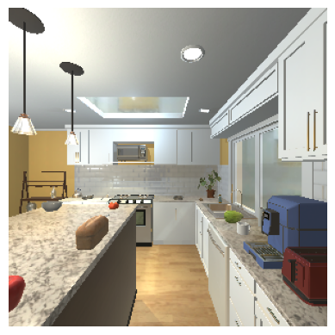


Method
Obstacle Detection
Olfactory Branch
Visual Branch
Toaster
AI2Thor Simulation Environment
Houseplant
Vision Sensing
Depth
Sensing
Stove
Navigation
Fusion Branch
Olfaction Sensing
Con: 0.9
Sense
Stove
Act

Slide 5
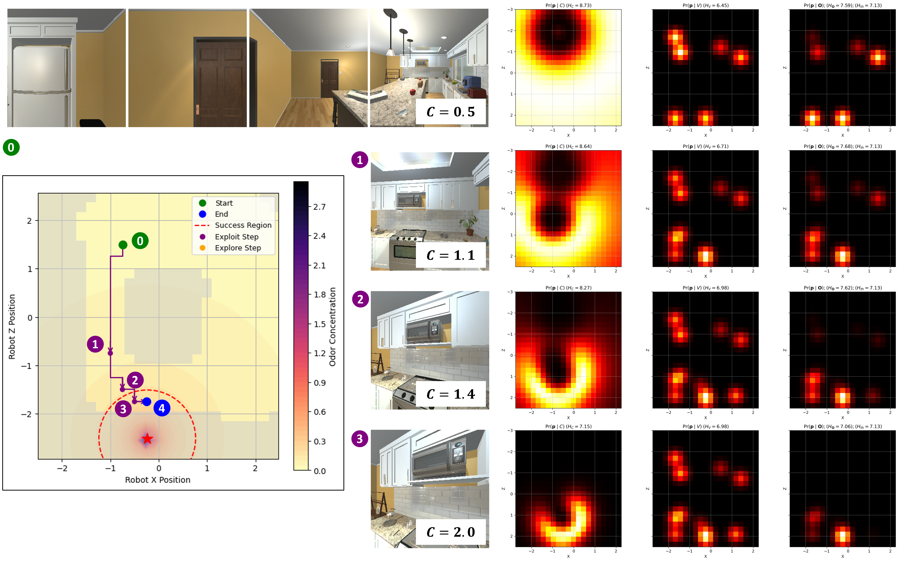
Results

Slide 6
Conclusion and Future Work
Hardware
Real world implementation on mobile robot and drone platforms.
On device (efficient) algorithms.

Slide 7


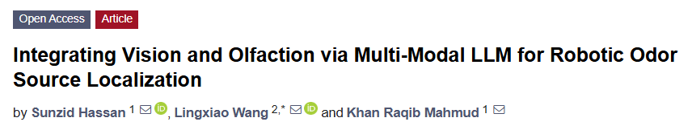

Thank You

